Slide 1
Crop Prediction & Disease Detection System Using Machine Learning Algorithms
Presented by:
Md Mossadek Touhid(1707068)
Rakib Hasan(1707014)
Supervised by:
Abdul Aziz
Assistant Professor
Department of Computer Science and Engineering
Khulna University of Engineering and Technology

Slide 2
Outline
Objectives
System Overview
Methodology
Dataset Descriptoin
Testing Image Using GUI
Result Analysis
Limitations and Future Work
Conclusion

Slide 3
Objectives:
To develop a system that selects a right crop according to the given climate and soil properties data.
To design the system for predicting crop and detecting crop disease.
To implement the designed system with a tkinter based GUI.
To carry out the testing process of the implemented system.

Slide 4
System Overview
Crop Prediction and Disease Detection System.
It has two parts.
One side is the prediction that is based on analyzing a static set of data using Machine Learning techniques that is Support Vector Machine(SVM) classification algorithm.
The other side is for disease detection with a tkinter based GUI, which detects the disease classifying given leaf’s image using Convolutional Neural Network(CNN) algorithm.

Slide 5
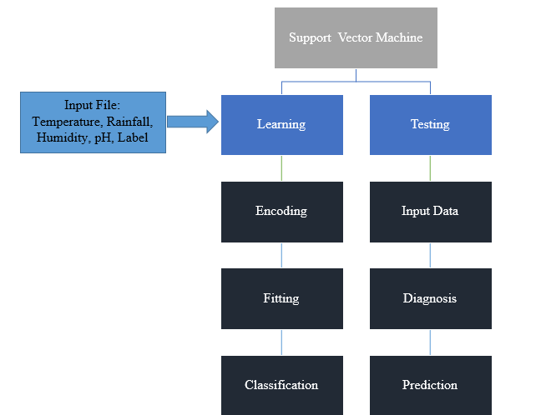
Fig. 4.1: Crop Prediction System Architecture

Slide 6
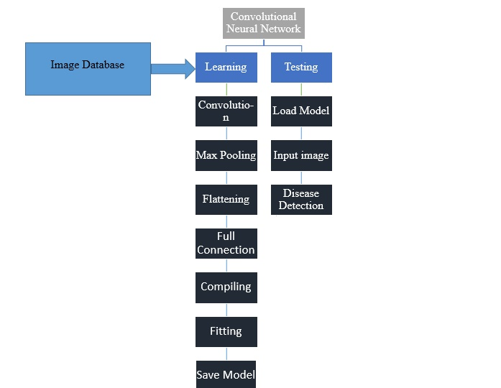
Fig. 4.2: Crop Disease Detection System Architecture

Slide 7
Methodology
Support Vector Machine:
It is one of the most popular supervised machine learning algorithm which is used for classification The goal of SVM algorithm is to create a best line or decision boundary, is called a hyper plane that can classify a new data in correct category.

Slide 8
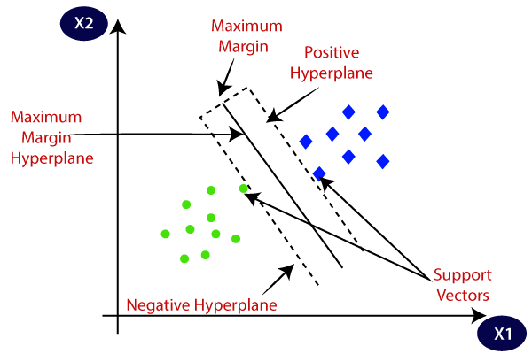
Fig. 3.1: Applied Methodology of SVM

Slide 9
Methodology(Cont.)
Convolutional Neural Network(CNN):
CNN is used to detect the disease in plant’s leaves. Four important feature in CNN are convolution, pooling, flatten and full connection. Convolution is used to detect edges of patterns in an image. Pooling is used to reduce the size of an image. Flattening converts the data into a 1-dimensional array. And while output could be flattened and connected to the output layer that represents a high level features in the data is call full connection.

Slide 10
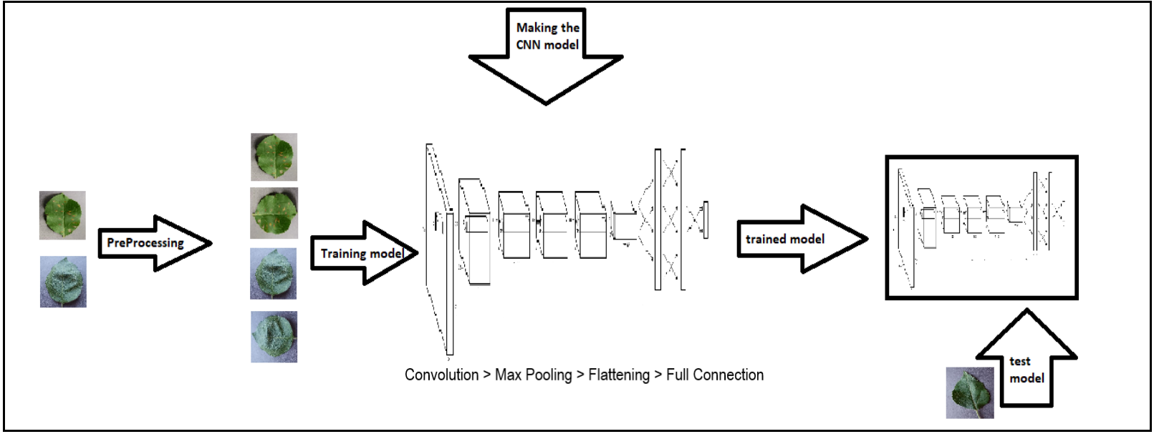
Fig. 3.2: Applied Methodology of CNN

Slide 11
Dataset Description
Table 4.1: Dataset for Crop Prediction (sample dataset only for Rice)
Temperature | Rainfall | Humidity | pH | Label
20.87974371 | 202.9355 | 82.00274 | 6.502985 | Rice
21.77046169 | 226.6555 | 80.31964 | 7.038096 | Rice
23.00445915 | 263.9642 | 82.32076 | 7.840207 | Rice

Slide 12
Dataset Description(Cont.)
Table 4.2: Dataset for Disease Detection(sample dataset only for Rice)
Plant’s Name | Healthy/Diseased | Disease Name | Images(Number)
Rice | Diseased | Bacterial Blight | 2112
Rice | Diseased | Blast | 1760
Rice | Diseased | Brown Spot | 2000
Rice | Diseased | Tungro | 1862

Slide 13
Testing Image Using GUI
Graphical User Interface:
We try to make GUI as simple as possible to ensure it becomes comprehensible to every user. Below, the screenshot of tkinter based user interface shown here:

Slide 14
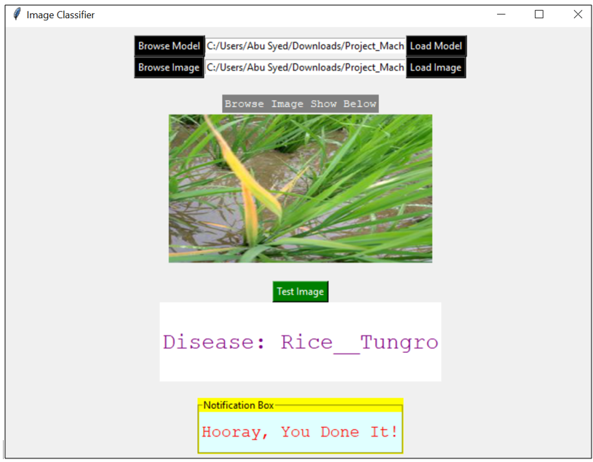
Fig. 4.3: Disease Detection Using GUI

Slide 15
Result Analysis
This model were developed using Deep Learning in python. Those images are from 21 different classes (46937 images).
This model give us 84.18% accuracy on those images as well by telling either leaf is healthy or diseased .
For detecting image, finally, the model utilizes the fully connected layers.

Slide 16
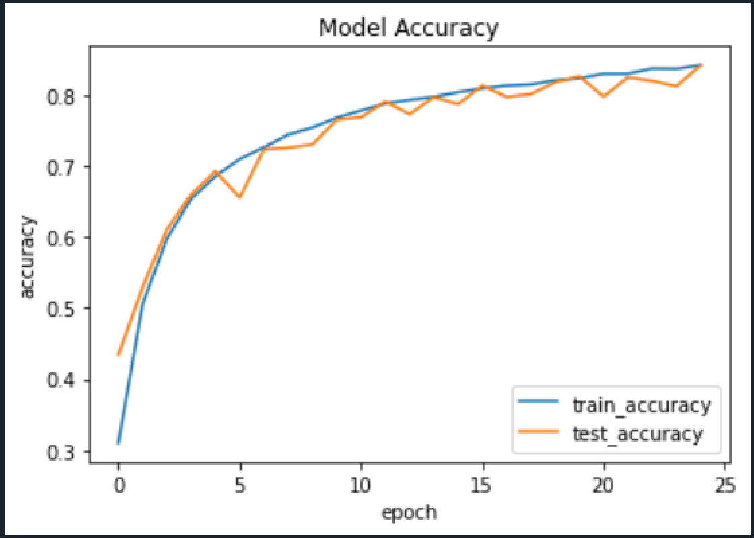
Fig. 5.1: Train-Test Accuracy on test dataset

Slide 17
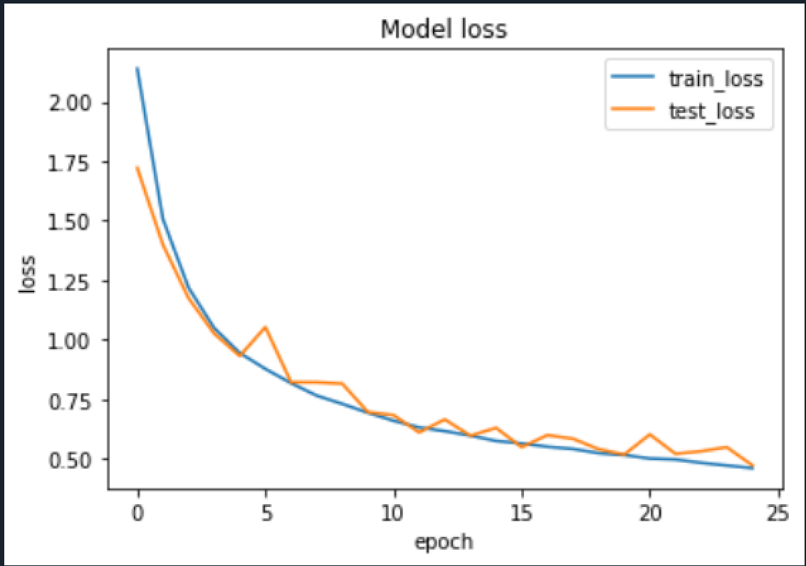
Fig. 5.2: Train-Test loss on test dataset

Slide 18
Limitations and Future Work
Limitations :
This system predict with only two parameters (temperature & rainfall) when predicting crop according weather dataset.
It can not detect real-condition image.
It is trained with only 21 classes it could not tell if the plant has a disease or not when it belongs outside that classes.

Slide 19
Limitations and Future Work(Cont.)
Future Work :
This system can be upgraded so that it can detect according to many parameter of weather condition.
It can be integrated into mini-drones to live detection of diseases from plants in cultivated areas.
It can also adopt 3 layer approach where the first layer detects if there’s any plant in an image or not, second layer tells the plant type and the third layer tells if there is any disease or not and what type of disease is there if any.

Slide 20
Conclusion
The proposed methodology in the crop prediction and crop's leaf disease detection system focus on generating an advance and efficient system.
It makes the process of creating high yield of crop much more easier for the farmers.
The project aims to predict crop and detect the most common diseases of crop.
Using this system, the farmer will be able to accurately detect the type of disease of a particular plant.
It aims to make the life of farmers easier.

Slide 21
References
[1] Yann LeCun, Yoshua Bengio, et al. Convolutional networks for images,speech, and time series.The handbook of brain theory and neural net-works, 3361(10):1995, 1995.
[2] I. Oliveira, R. L. F. Cunha, B. Silva, and M. Netto. A scalable machinelearning system for pre-season agriculture yield forecast.2018 IEEE 14thInternational Conference on e-Science (e-Science), pages 423–430, 2018.
[3] L. Sherly Puspha Annabel, T. Annapoorani, and P. Deepalakshmi. Ma-chine learning for plant leaf disease detection and classification – a review.In2019 International Conference on Communication and Signal Process-ing (ICCSP), pages 0538–0542, 2019

Slide 22
Thank You Any Questions?

